Slide 1

Olympic Games
Can Data Predict How Countries will Perform?

Slide 2
Introduction
Is it possible to predict how well a country will do in the Olympics?
Outside of specific strategies and training for sports, is it possible to tell whether a country will do well or not based on population and economic data?
Are more populous countries more likely to win Olympic medals?
Are countries with higher GDP (Gross Domestic Product) winning more medals?
Are countries with growing population and growing GDP performing better over time?

Slide 3
Data
Why these data sets?
We were looking for data sets that contained: number of medals, country, Olympic year, type of Olympic event, so that we could cross-reference with them with GDP and Population data trying to find trends or correlations.
Data Sets Used: Olympic Athlete Event Analysis, Olympic Games Medals 1896-2018, Country Wise GDP from 1994 to 2017 (Kaggle.com)
Were there any problems with the data?
Overlapping information
Olympic Athlete Event Analysis was removed
Sorting data by athlete was confusing and produced duplicates
Discrepancies in country names, countries have changed names or become new independent countries.
Russian Olympic Committee, IOC Refugee Olympic team, Great Britain x United Kingdom, etc..
Missing total medal counts for event, country, or year.

Slide 4
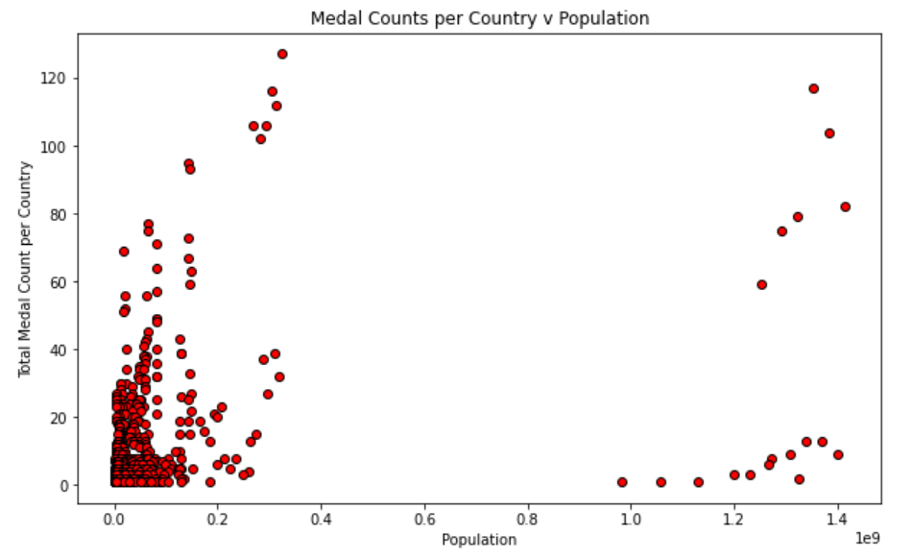
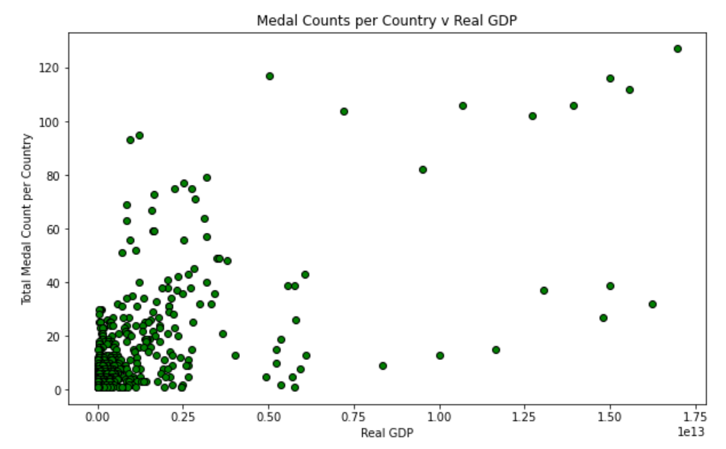
What story is the data telling?
What initial impressions do we have of the data?
The data seems to show that the model works well for countries with small population, but not necessarily for larger populations
What does the data show?
What conclusions can we take from the data and its visualizations?

Slide 5
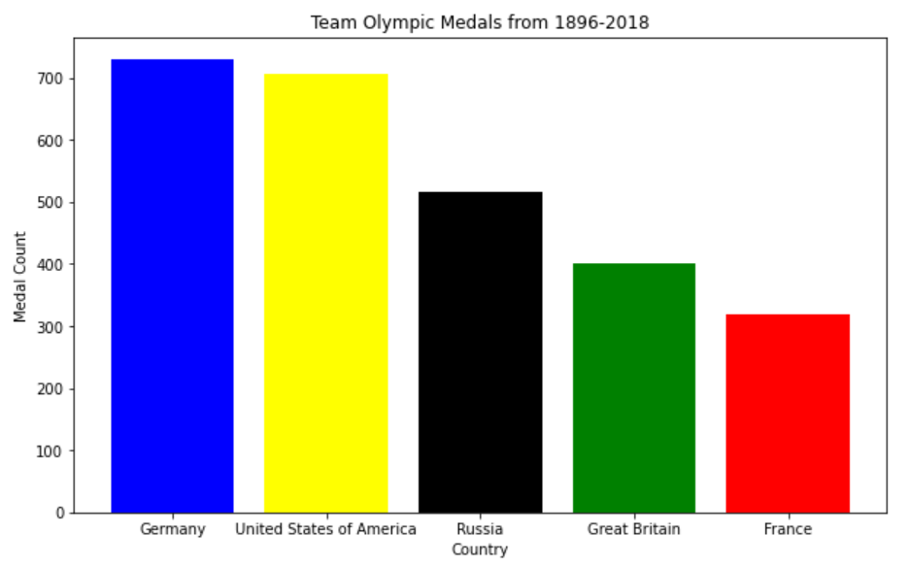
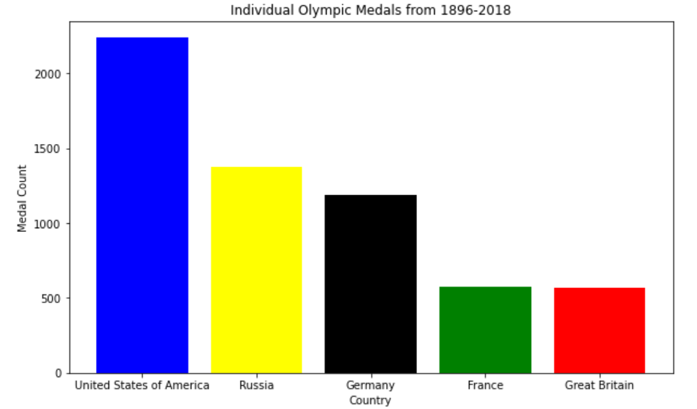
Top 5 Countries with Total Medal Count from 1896-2018

Slide 6
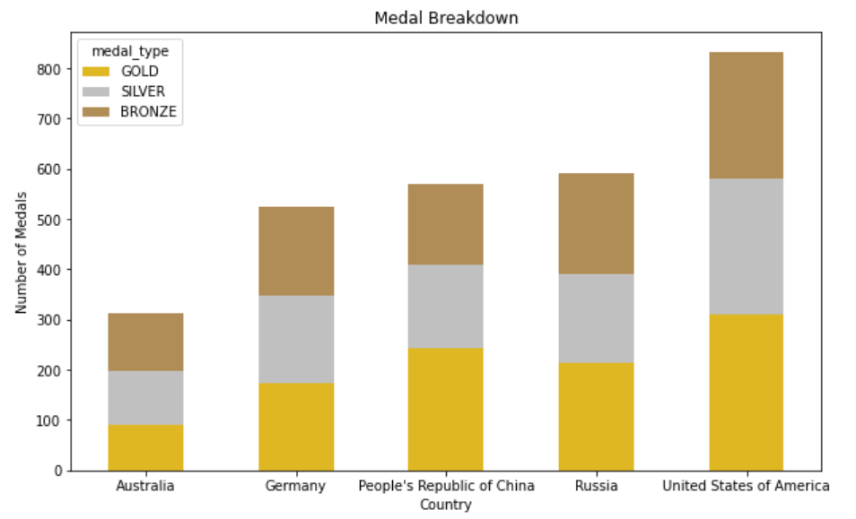
Top 5 Countries with Medal Breakdown from 1996-2018 (combined with GDP and Population data)

Slide 7
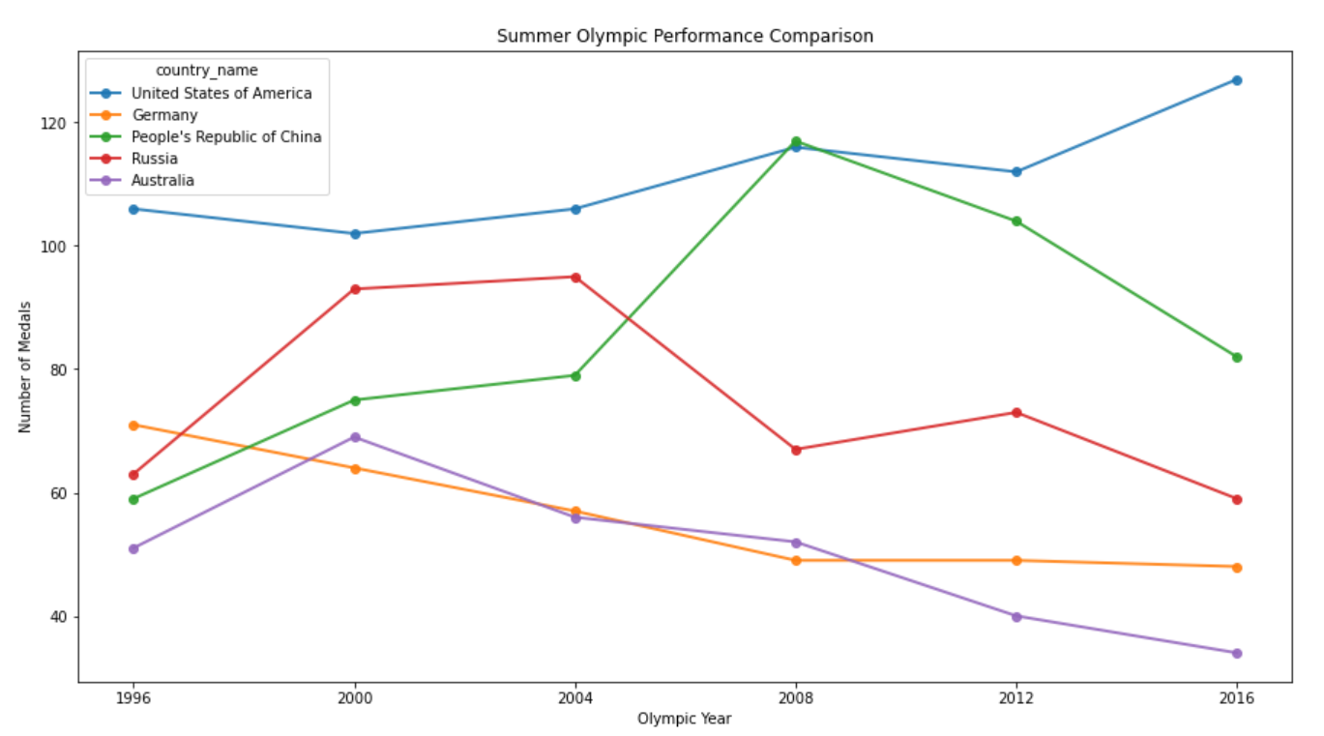
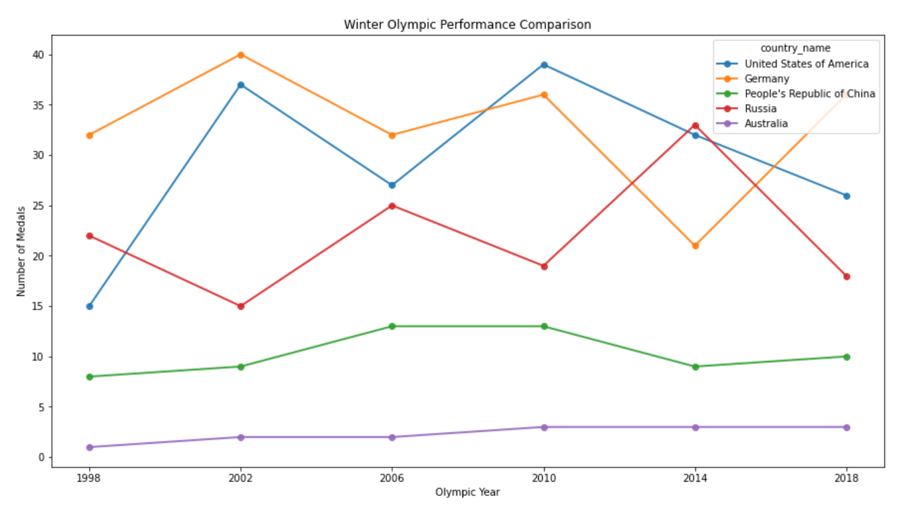
Top 5 Countries with Total Medal Count from 1996-2018

Slide 8
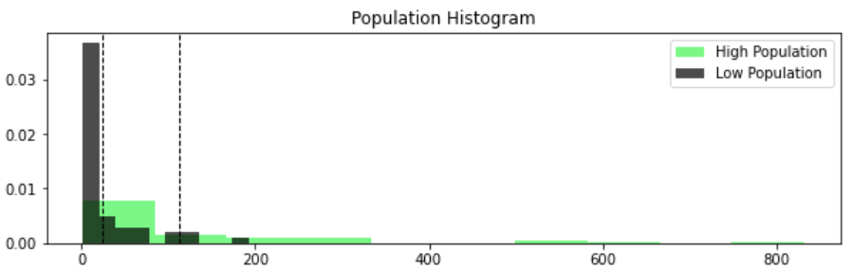
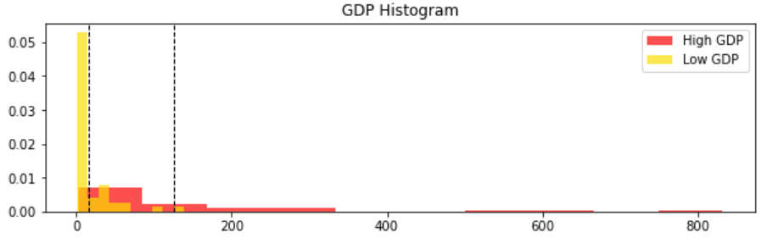
T-test with Population and GDP
High Population versus Low Population
HYPOTHESIS
These samples came from different distributions - THERE IS a SIGNIFICANT difference in means.
NULL HYPOTHESIS
These samples came from the SAME distribution - THERE IS NOT a difference in means.
High GDP versus Low GDP
HYPOTHESIS
These samples came from different distributions - THERE IS a SIGNIFICANT difference in means.
NULL HYPOTHESIS
These samples came from the SAME distribution - THERE IS NOT a difference in means.

Slide 9
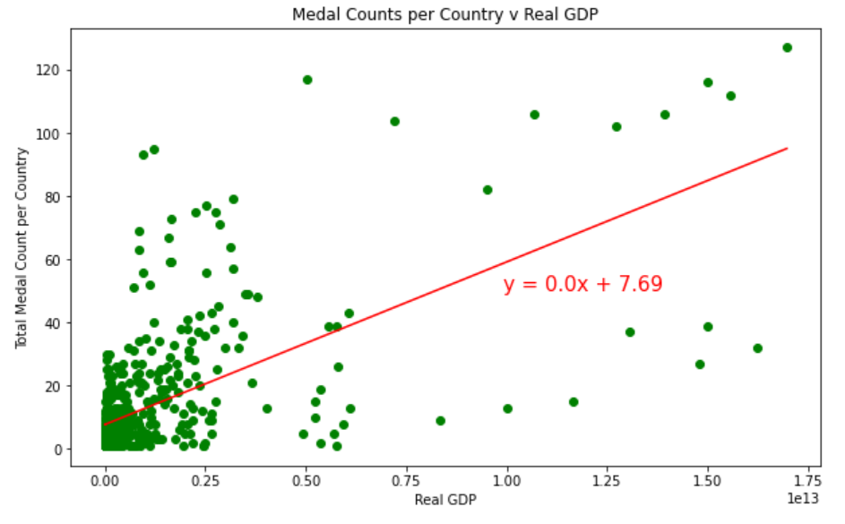
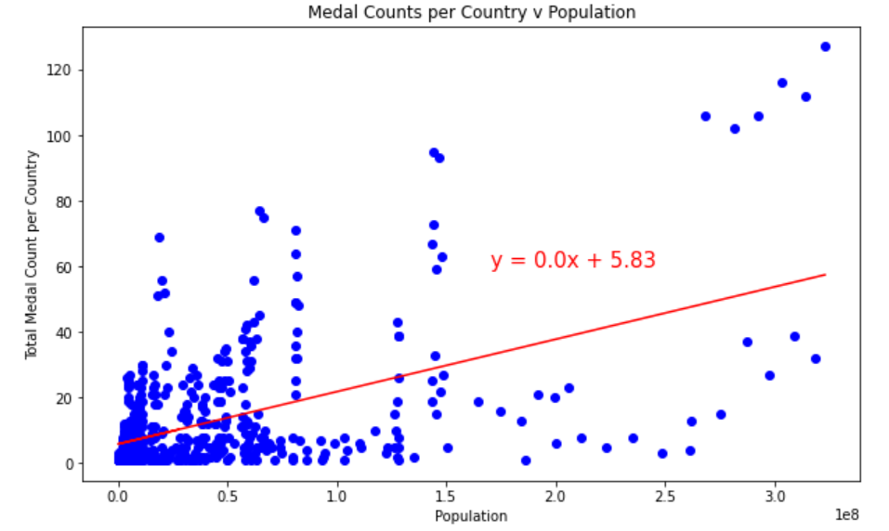
Regression for GDP and Population

Slide 10
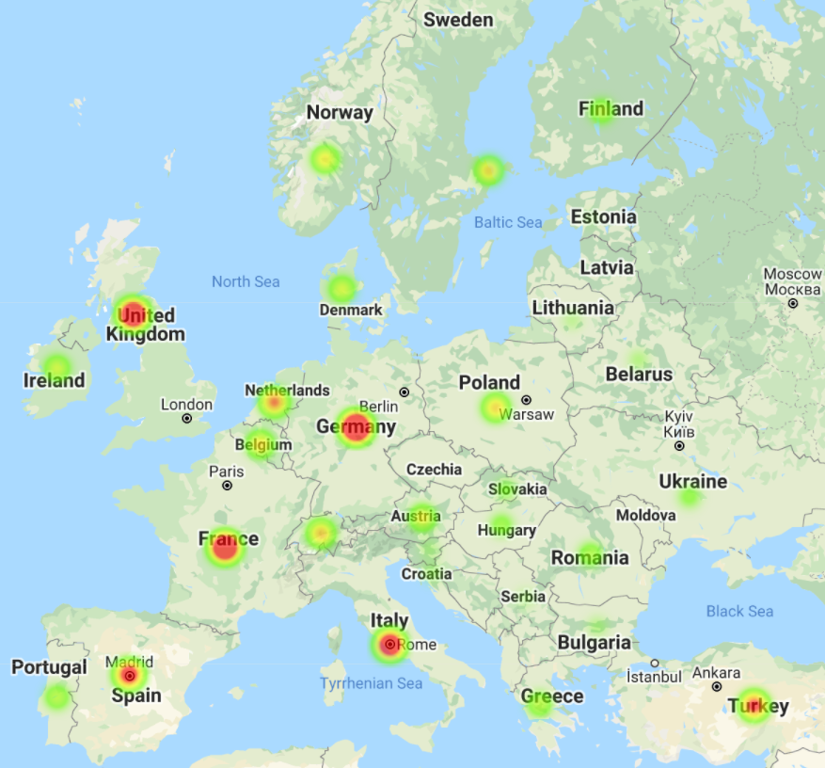
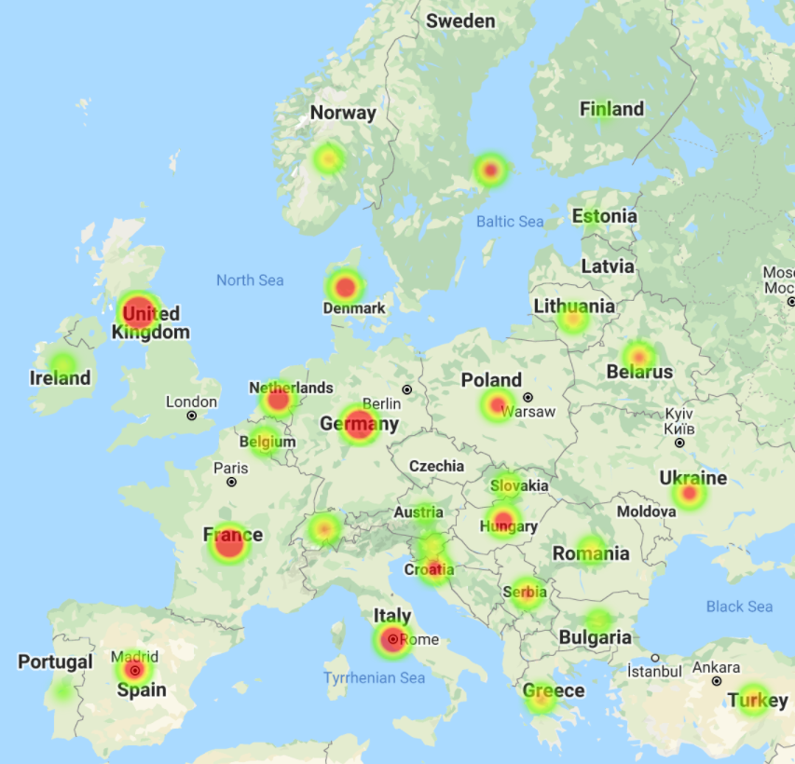
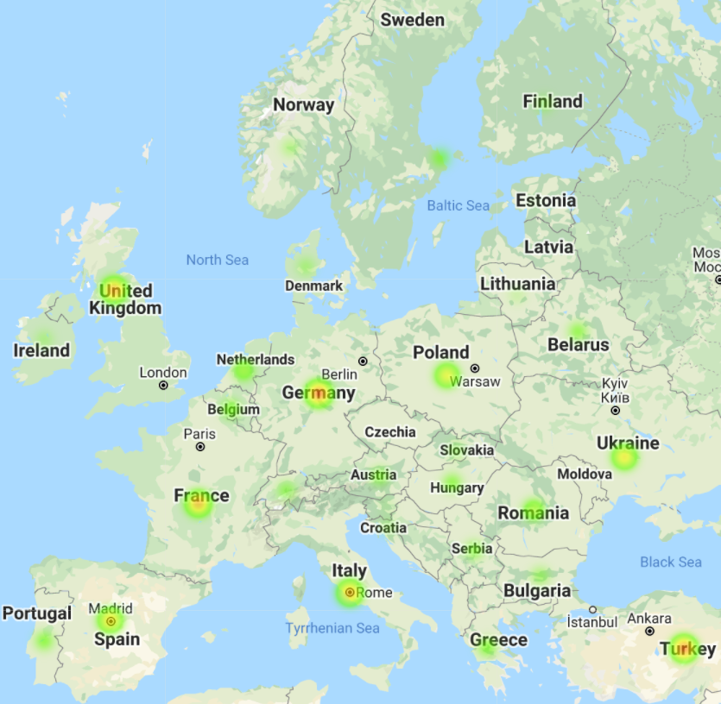
Heatmap Activity in Europe
Medals Won
GDP
Population

Slide 11
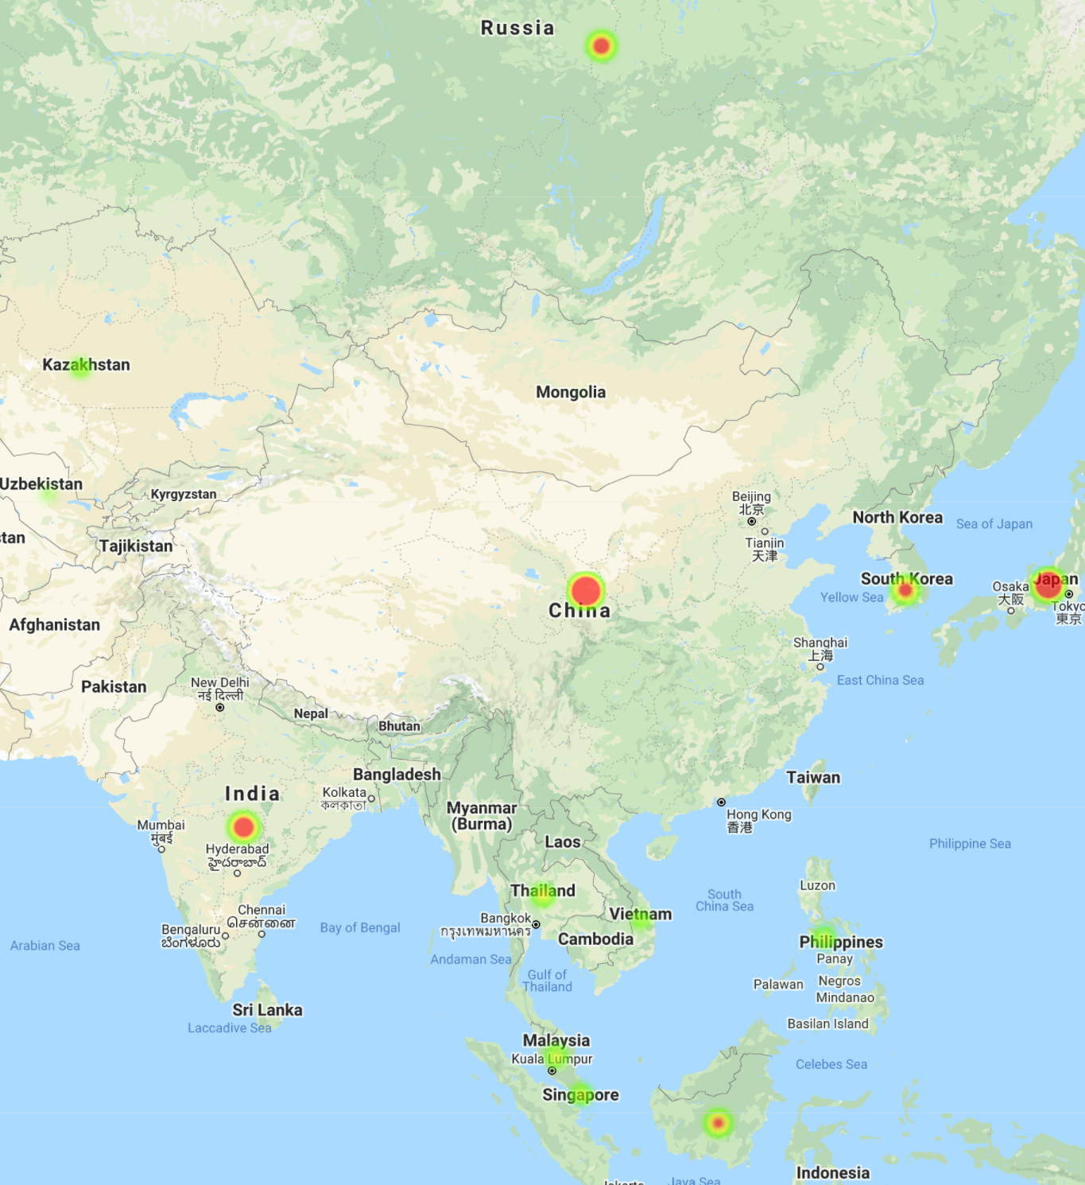
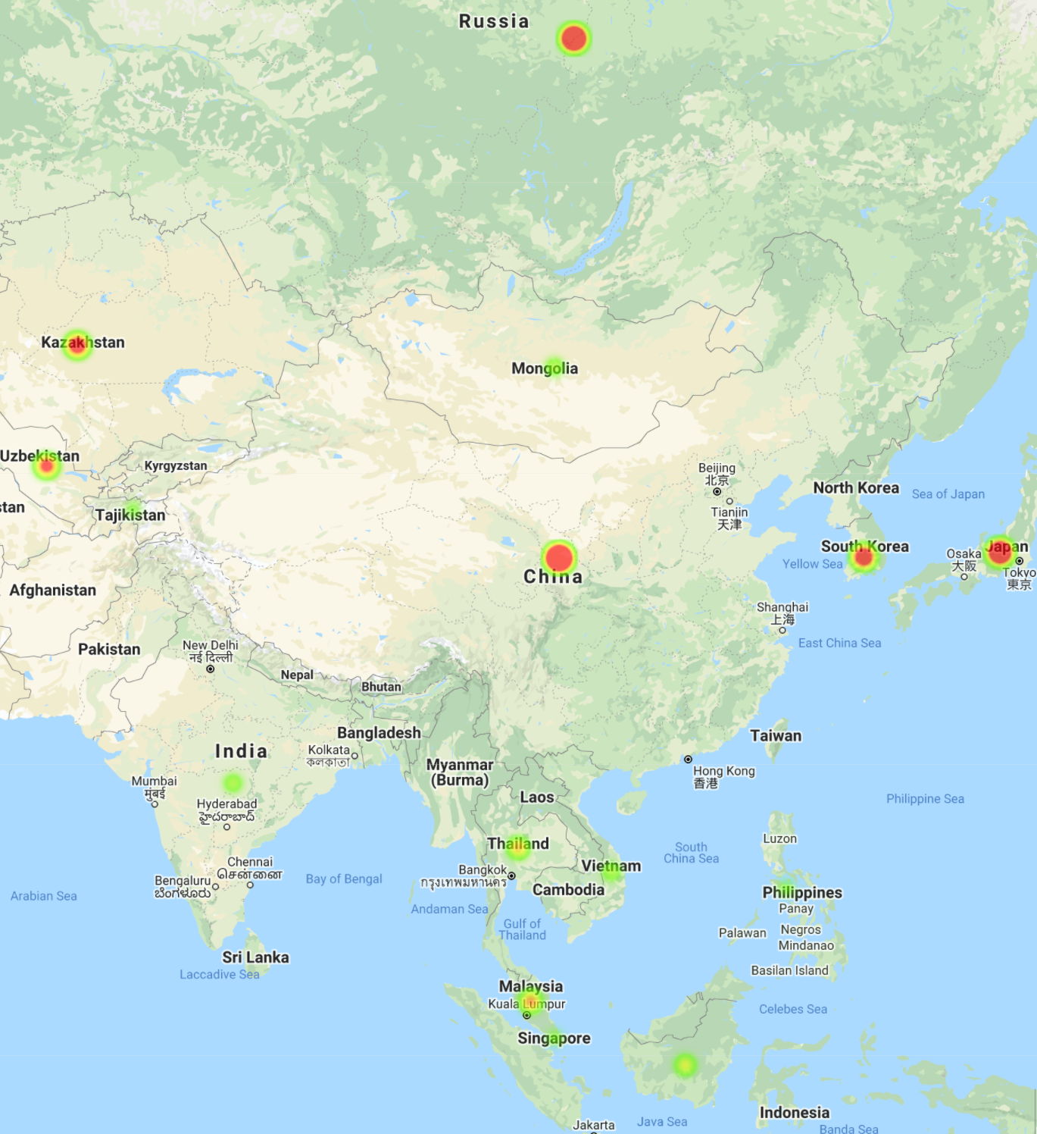
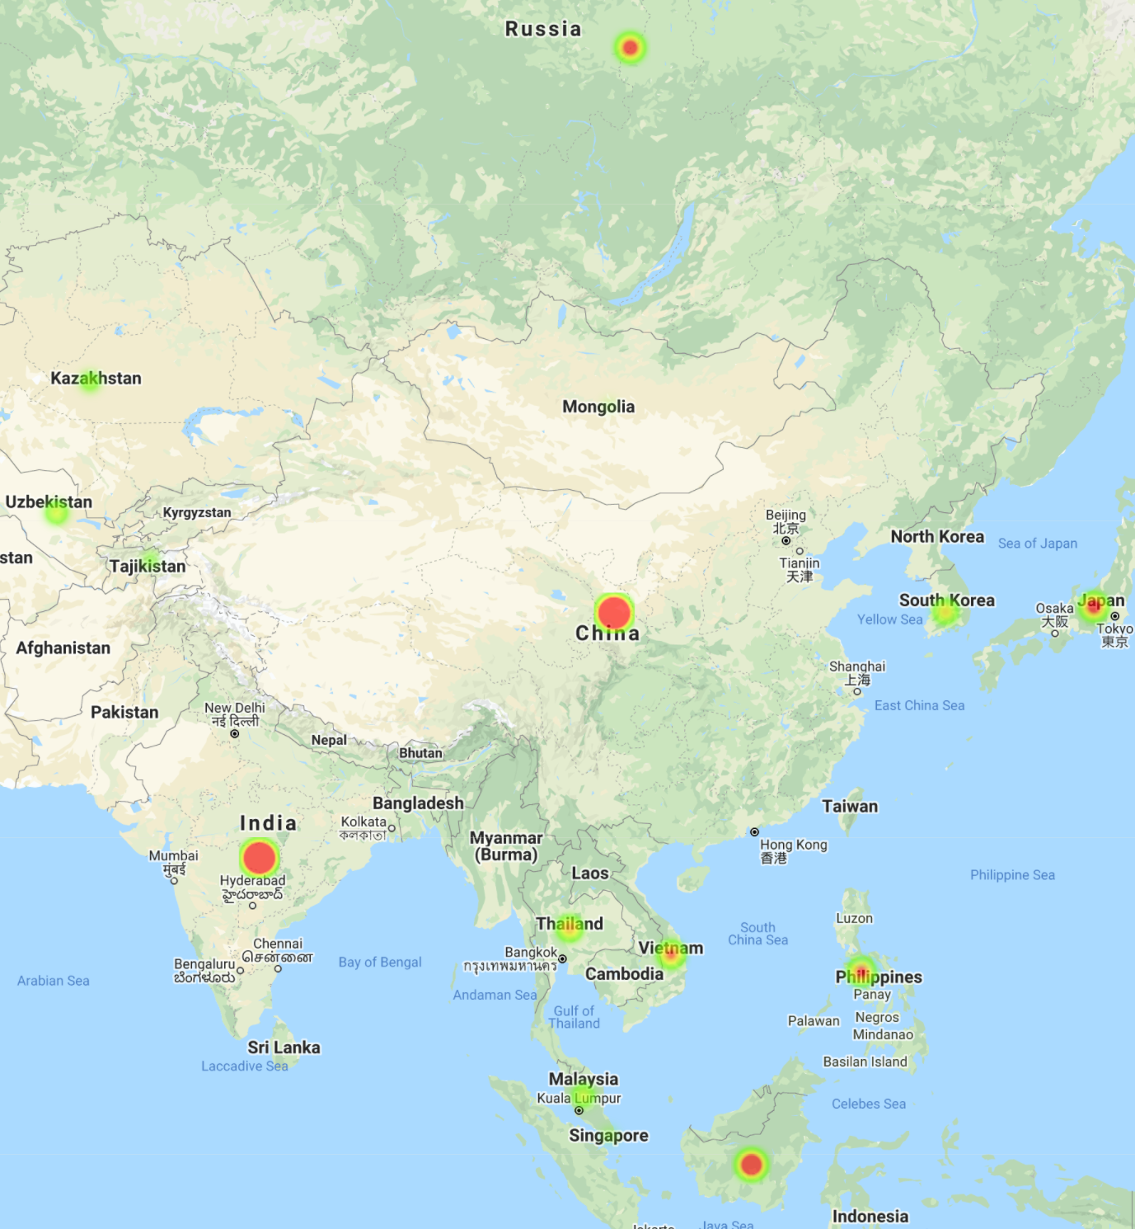
Heatmap Activity in Russia/Asia
GDP
Medals Won
Population

Slide 12
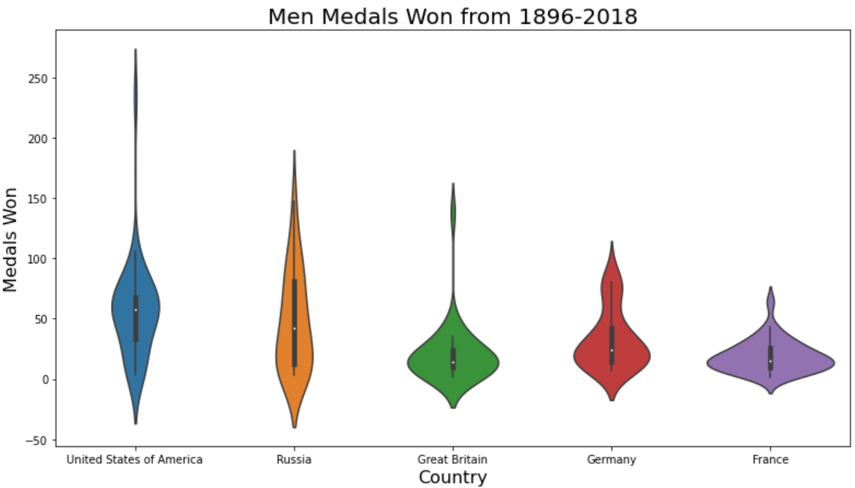
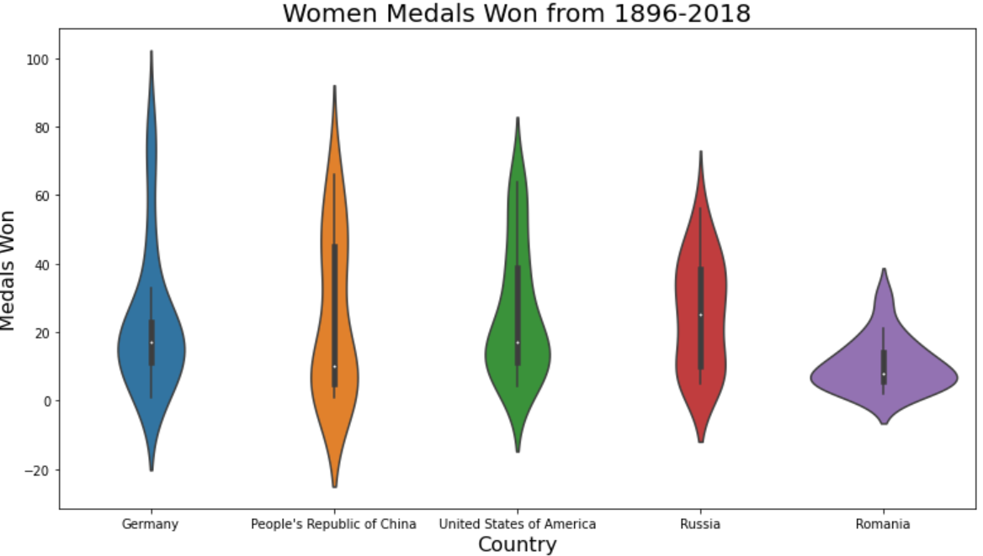
Other Observations

Slide 13
Calls to Action
Can we predict how a country will do in the Olympics based on their GDP or Population
If a country increases their population by X would they perform better in the Olympics?
If a country increases their GDP by X will they perform better in the Olympics?

Slide 14
Limitations
If resources were unlimited, what would you do differently? What would you have explored? What would you have attempted?
Performance comparisons between N. America x Western Europe
GDP/Population influencing performance by gender
Can demographic data and GDP help predict if Olympic records would be broken?
Sub-groups: team sports x individual sports, track and field, indoor x outdoor sports…

